Slide 1
Data Structure and Algorithm DSA

Slide 2
Data Structure
Data structure is a collection of data values, the relationships among them, and the functions or operations that can be applied to the data.
What actually data structure is?
It’s an agreement about:
how to store a collection of objects in memory,
what operations we can perform on that data,
the algorithms for those operations, and
how time and space efficient those algorithms are.
It is the study that how can we manage data on RAM and what operation can be perform by them.
Data Structure = Data + Operation on the data

Slide 3
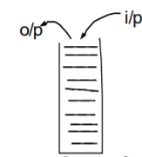
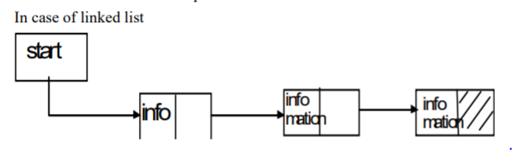
Data structure can be classified as:- 1. Linear data structure:-
Processing of data items by linear fashion is linear data structure e.g. array, stack, queue, linked list.
In case of stack:- -Last input is the first output
1 input process is called push.
2 Output process is called pop.
In case of queue - First input is the first output.
3 Input is called rear.
4 Output is called front.
First part consists of information and second part consists of pointer to second block.

Slide 4
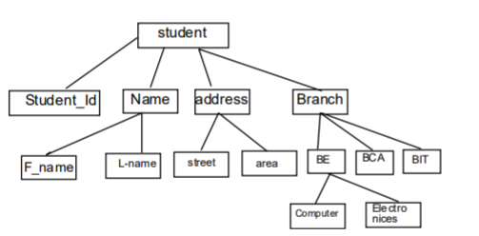
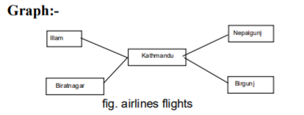
Non Linear data structure:-
A data structure in which insertion and deletion is not possible in a linear fashion is called non –linear data structure. E.g. tree, graph.
- It is hierarchical in nature.
- Contents relationship between pair of elements which is not in hierarchical in nature.

Slide 5
Algorithm
“An algorithm is a finite set of precise instructions executed in finite time for performing a computation or for solving a problem”.
To represent an algorithm we use English language however for simplicity we can use pseudocode to represent the algorithm.
Pseudocode represents an algorithm in a clear understandable manner as like English language and gives the implementation view as like programming language.

Slide 6

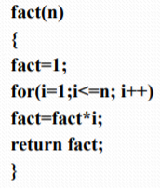
This algorithm is for getting factorial of n.
The algorithm first assigns value 1 to the variable fact and then until n is reached , fact is assigned a value fact*I where value of I is from 1 to n. At last the value fact is returned . The pseudocode used here is loosely based on the programming language C.

Slide 7
Characteristics (Properties) of algorithm
Input : An algorithm has input values from a specified set.
Output : from each set of input values, an algorithm produces output values from a specified set. The output values are the solution to the problem.
Definiteness : The steps of an algorithm must be defined precisely.
Correctness : An algorithm should produce the desired output after a finite(but perhaps large)number of steps for any input in the set.
Effectiveness: It must be possible to perform each step of an algorithm exactly and in a finite amount of time.
Generality : The algorithm should be capable of solving the problem of similar kind for all possible inputs.

Slide 8
Complexity of algorithms
When an algorithm is designed, it must be analyzed for its efficiency.
The efficiency of an algorithm is measured in terms of complexity.
The complexity of an algorithm is defined in terms of computational resource needed by the algorithm.
There are two kinds of computational resources used by an algorithm : CPU’s processing power(TIME COMPLEXITY ) and computer’s primary memory ( SPACE COMPLEXITY).

Slide 9
Complexity of algorithms
The measure of time required by an algorithm to run is given by time complexity and the measure of space (computer memory) required by an algorithm is given by space complexity.
We focus mostly on time complexity of an algorithm which is given by the number of operations needed by an algorithm for a given set of inputs.
Since actual time required may vary from computers to computers(e.g. on a supercomputer it maybe million times faster than on a PC), we have to use the number of steps required by the algorithm for a given set of inputs to measure the time complexity.

Slide 10
Example(Time complexity):
We can find the time complexity of the above algorithm by enumerating the number of steps required for the algorithm to obtain the factorial of n.
We can clearly see that the assignment of the variable fact is done once, the for loop executes n+1 times, the statement inside the for loop executes n times and the last operation that is the return statement executes single time.
Thus the total time in terms of number of steps required for finding the factorial of n can be written as:
f(n)= 1+(n+1)+n+1=2n+3.

